Slide 1
Minefield BMS system based on Freescale Kinetis Microcontroller
YangXi
System and Application
Suzhou MCU Apps Team
August 2013

Slide 2
Next Generation of BMS
Overview
Basic theory
Hardware design
Software design

Slide 3
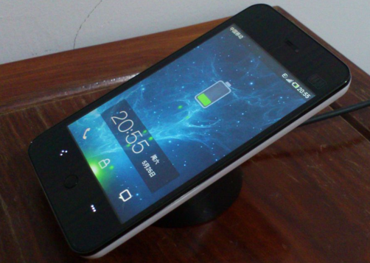

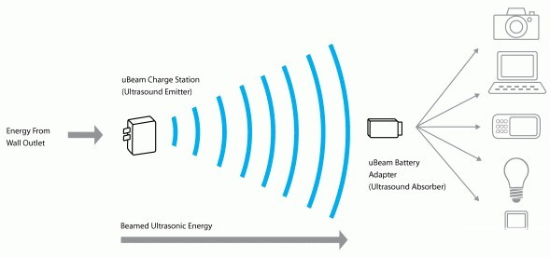
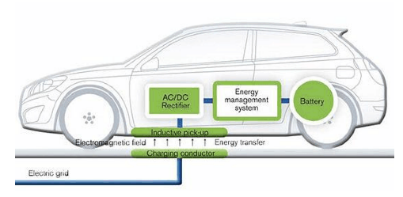
Overview
Wireless Charging Technology

Slide 4


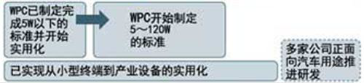


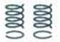
Overview
Wireless Charging ways | Power Supply(W) 1 10 100 1000 | Efficiency | Frequency | Distance
Electric Coupling
Electromagnetic Induction |  | 92% | 22KHz | mm-cm
Magnetic Resonance |  | 95% | 13.56MHz | cm-m
Radio Wave | In the experimental stage | 38% | 2.45GHz | m-

Slide 5
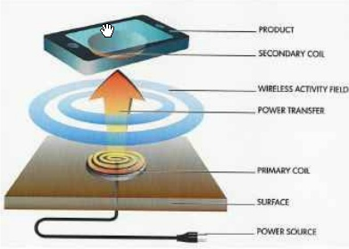
Overview
dB/dt
I
Wireless Charging Technical standards
Power Matters Alliance(PMA) |  | Launched by Duracell Powermat
Qi |  | Launched by Wireless Power Consortium (WPC)

Slide 6
Overview
Base Station
Mobile Device
Transmitter
Transmitter
Receiver
Transmitter
Control
Comm
Message
Comm
Control
System
Reflected Load
Load
DeMod
Mod
Power Conversion
Power
Power Pick-up
Transmitter(Tx):
1) Receive control information
from the receiver;
2) Adjust the desired operation point
to meet the need of the receiver.
Receiver(Rx) :
1) Send messages to provide
control information to the
transmitter;
2) Control the power to the output
load.
Demodulation---Modulation

Slide 7
Wireless Charging
Overview
Basic theory
Hardware design
Software design

Slide 8
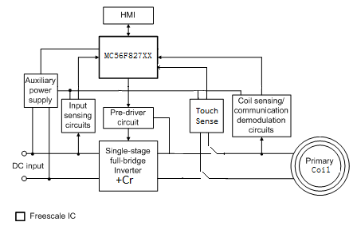
Basic theory
A11:
Single-stage full-bridge inverter
Resonant circuit
Primary coil
touch sensor
Sensing circuits
Pre-driver circuit
Communication demodulation circuit
Auxiliary power supply
HMI
parameters | control algorithm
Transfer efficiency: Up to 75%(there is different efficiency with different Receiver) Input voltage: 4.2Vdc to 5.5Vdc (4.2 can load 2.5W) Output power: up to 5W Standby current: <10mA ; < 5mA(with Touch function); Operation frequency Range: 110 kHz ~ 205kHz Communication baud rate: 2kbps Power stage topology: full bridge with LC resonant circuit | WPC “Qi” communication protocol One coil control Output voltage closed-loop control – PID regulation Current limitation Faults protection Safety functions, such as foreign metal object detection(FOD) Low standby power control with touch function Low EMI issue in standby state

Slide 9
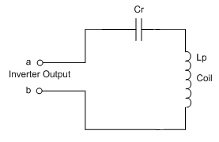
Basic theory
Full-bridge Inverter with Resonant Network
Full-bridge inverter:
Converse DC to AC Motor drivers;
High DC voltage utilization;
Unipolar fixed-duty cycle PWM control
to reduce EMI.
Resonant network:
Convert AC square wave to sinusoidal wave;
Operate in soft switching mode;
Improve power transfer efficiency through
transformer.

Slide 10
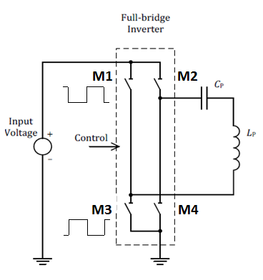
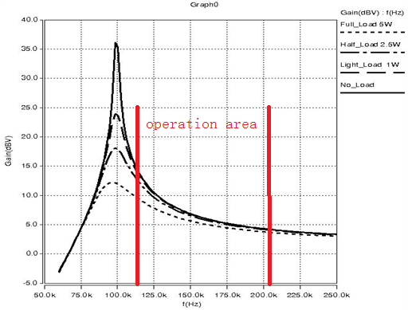
Basic theory
LC Resonant Switching Frequency Control Theory
The voltage on Lp can be changed by adapting the work frequency. The
operation area is set on the right side of the resonance frequency point.
The duty cycle is 50%, and the switching frequency of inverter is from 110kHz to 205kHz, while the resonance frequency is 100kHz.
The frequency is lower, the load-bearing ability is stronger.

Slide 11
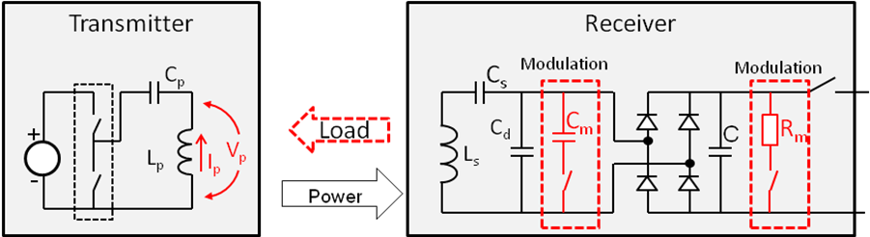
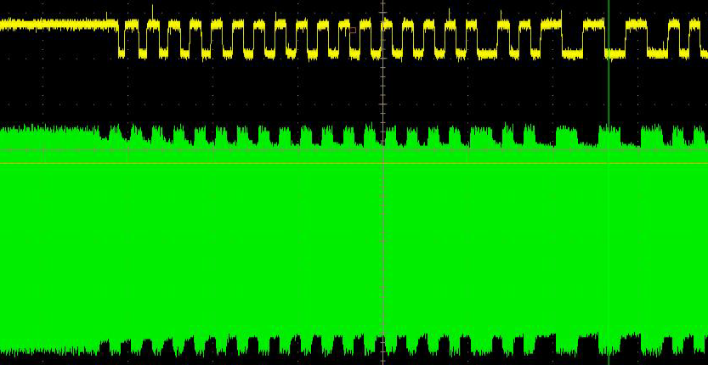
Basic theory
Communication Demodulation theory
Receiver modulates load by switching modulation resistor (Rm), or switching
modulation capacitor (Cm) . The voltage scale on the primary coil will decrease
when the communication capacitor added on the RX side with 2K BPS.
. Transmitter de-modulates reflected load by sensing primary coil current
changes (Δip > 15mA), or sensing primary coil voltage changes (ΔVp > 200mV)

Slide 12
Basic theory
System Control Strategy
Ip^{(j)}=(1+1/128ΔC^{(j)})Ip^{(j-1)}

Slide 13
Wireless Charging
Overview
Basic theory
Hardware design
Software design

Slide 14
Hardware design
A11’s structure

Slide 15
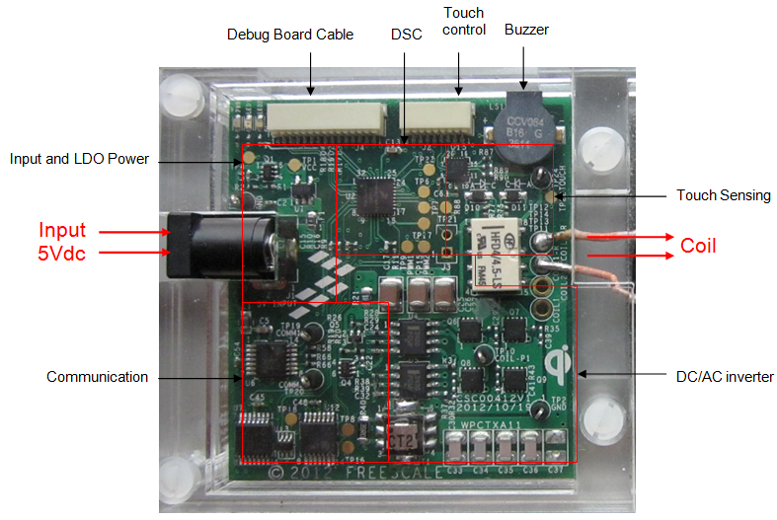
Hardware design

Slide 16
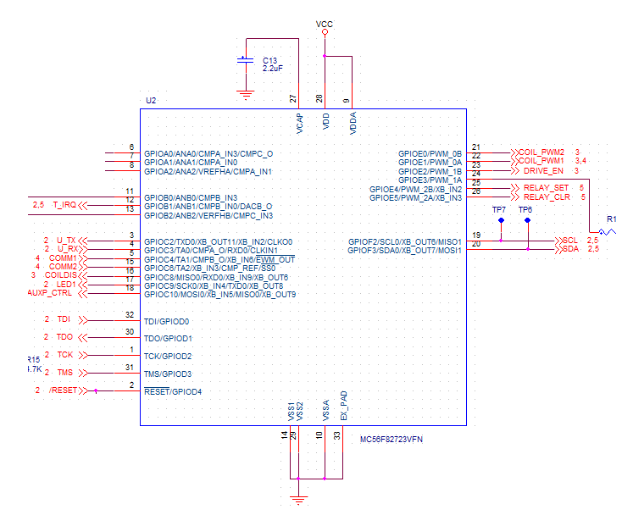
Hardware design
Control Part: DSC—MC56F82723
Peripherals:
RTC: Real time counter
PWM: PWMA, PWMB
ADC: ANA0~1,ANB0,ANB2
GPIO:
LED, COM, PWM…
Dual Timer: TMR0,TMR1
JTAG
I2C: SCL,SDA

Slide 17
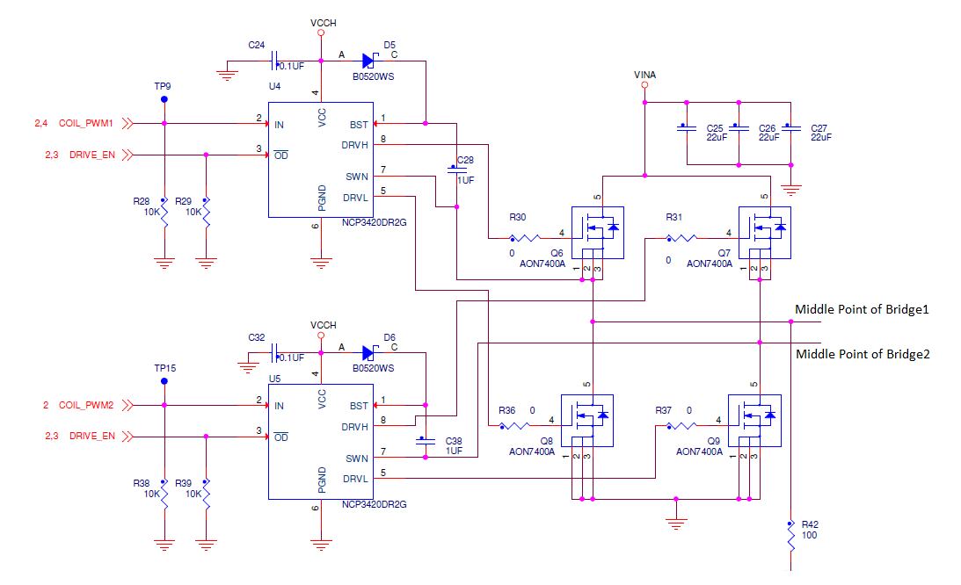
Hardware design
Full-Bridge Inverter Design

Slide 18
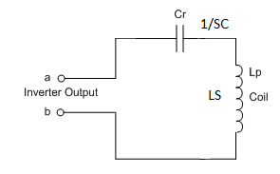
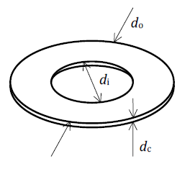
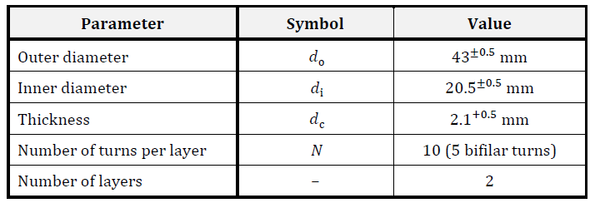
Hardware design
Resonant Network Design
Cr = 400nF, Lp= 6.3uH

Slide 19
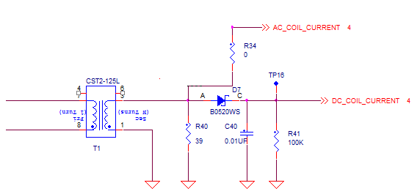
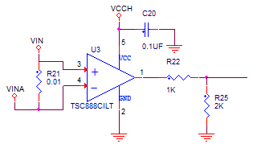
Hardware design
Sensing Circuits Design
Coil Current Sensing with
Current Transformer
Input Current Sensing with
Current Sense Amplifier

Slide 20
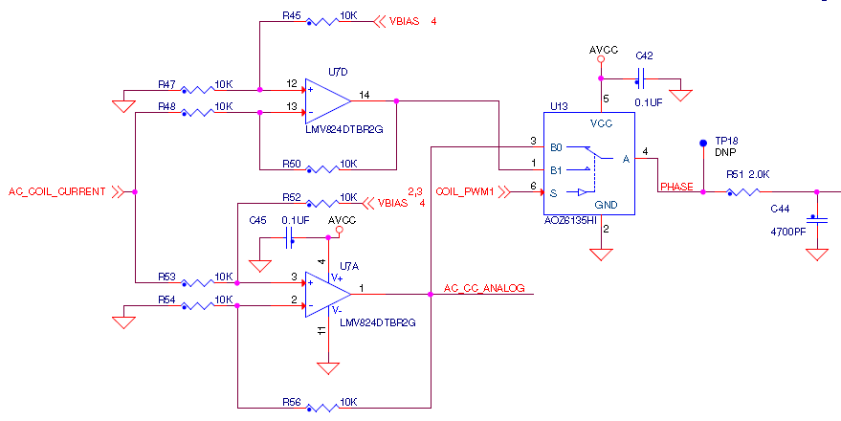
Hardware design
Communication Demodulation Circuit Design
The process of Analog Demodulation:
5kHz Low pass filter (LPF)
Pulse Amplifier Circuit
Voltage Comparator
Rectify and DC filter part

Slide 21
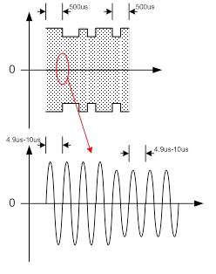
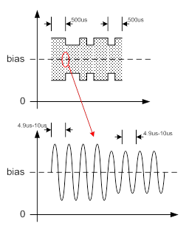
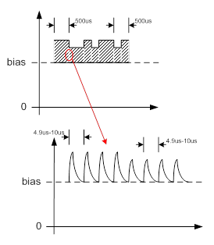
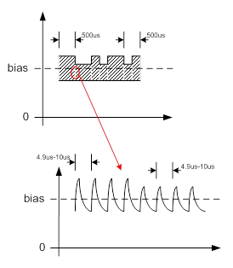
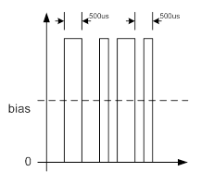
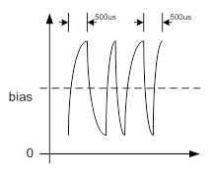
Hardware design
This picture is not A11’s situation, but it can explain the demodulation process of A11 more or less.

Slide 22
Wireless Charging
Overview
Basic theory
Hardware design
Software design

Slide 23
Software design
1. Software Architecture
SW layer: Application Layer, Control Layer, Hardware Layer and Processor Layer
SW modules

Slide 24

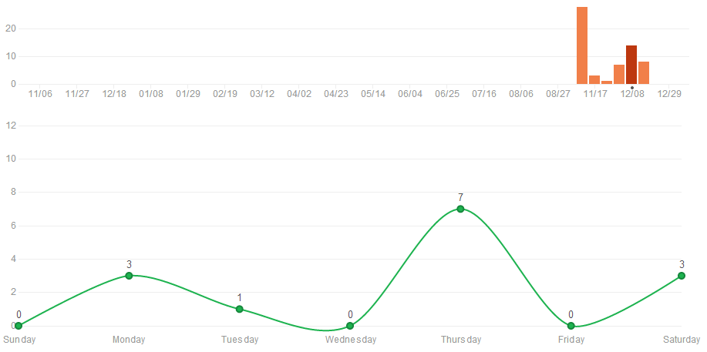
Software design: code delegate
Git: The BEST code delegate tool in the world for free!
Linux source code is delegated by git
For more detail. You can reference to : http://git-scm.com/
Our BMS project git resp: https://github.com/yandld
Code updated frequency of BMS software project
7 commits in a single day

Slide 25
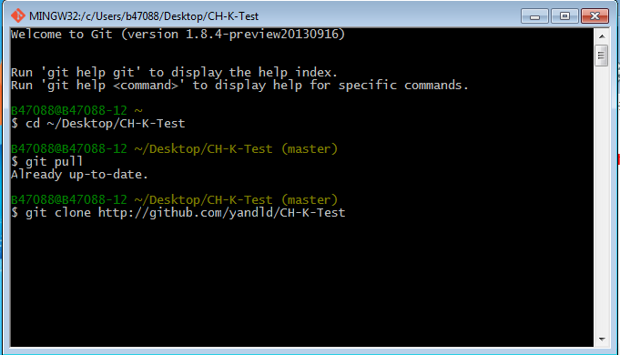
Software design: code delegate
Download project source code by using git bash
Git clone: http://github.com/yandld/CH-K-Test

Slide 27
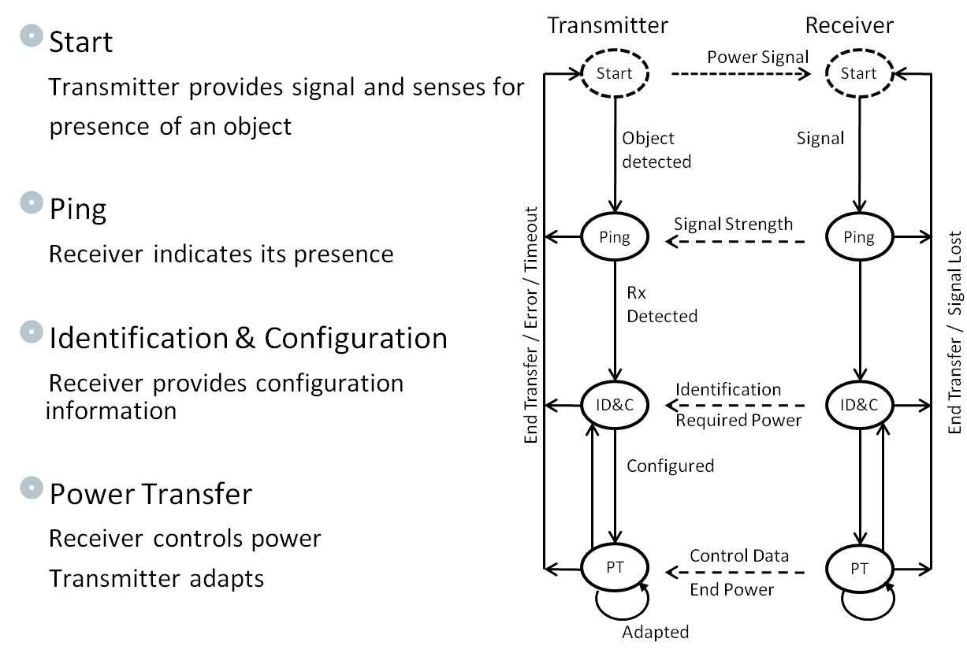
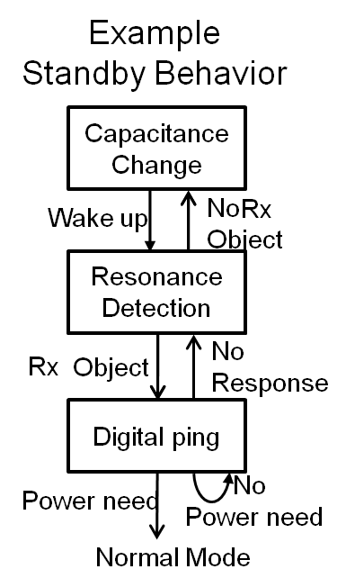
Software design
2. System Software Structure
Standby Power Mode

Slide 28
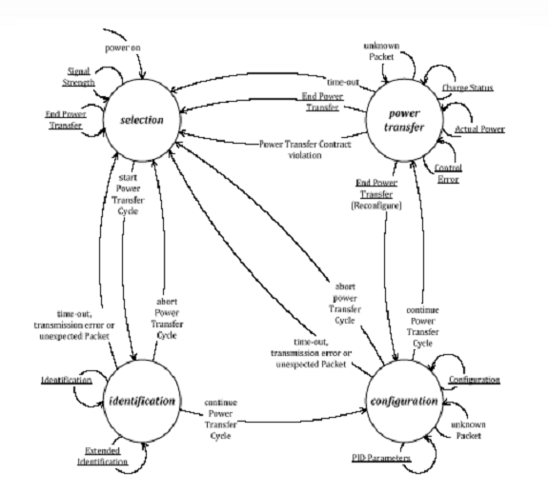
Software design
System state machine

Slide 29
Software design
3. System Parameters
System Parameters:
Operating Parameters:
LED Operation On/Off and Blink Bitfields
•LEDx Initialization State
•LEDx STANDBY State
•LEDx Power Xfer State
•LEDx Device Charged State
•LEDx Fault State
LED Display Timing
•Fault Blink Rate (ms)
•Operational State Blink Rate (ms)
•Delay at power-up (ms)
PWM Dead Time
•Default PWM Dead Time (ns)
WPC Diagnostics Bitfield
•Debug PID Operation
•Debug Operational State
•Debug Comm Status
•Debug FOD Operation
WPC Protections Bitfield
•Shutdown on Version Mismatch
•Power Timeout Shutdown Enabled
•Analog Ping Disable
Digital Ping
•Frequency (Hz)
•Pulse Duration (ms)
•Ping Interval (ms)
Analog Ping
•Frequency (Hz)
•Coil Current ∆Threshold (ADC counts)
Signal Detection
•Over Current Threshold (mA)
•Safety Input voltage Threshold (mV)
•Input Power Threshold (mW)
Operating Frequencies
•Minimum Freq (Hz)
•Maximum Freq (Hz)
PID Parameters
•Integral Limit
•PID Output Limit
•Proportional Gain (Kp)
•Integral Gain (Ki)
•Derivative Gain (Kd)
Duty Cycle Control
•Maximum Duty Cycle (%)
•Minimum Duty Cycle (%)

Slide 30
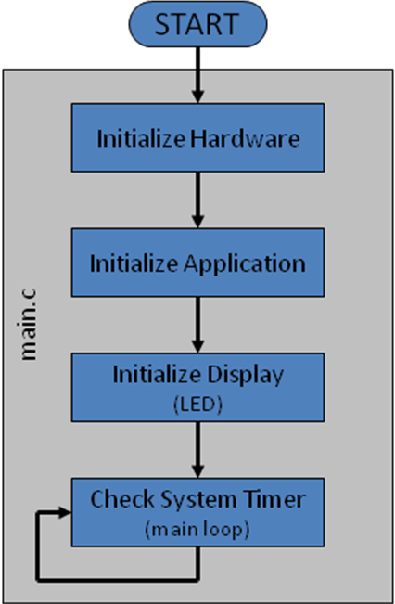
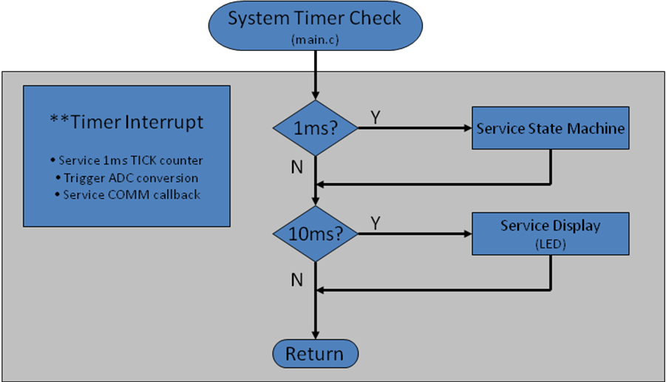
Software design
4. Software Modules Flow Chart
Program flow chart of boot
Transmitter Run-Time Operation

Slide 31
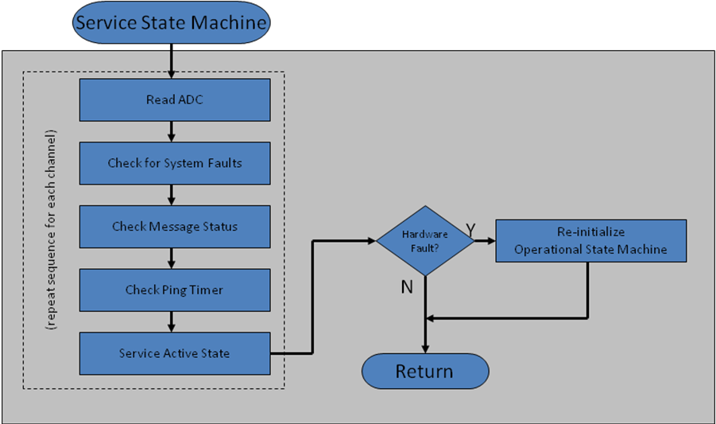
Software design
Main state machine

Slide 32
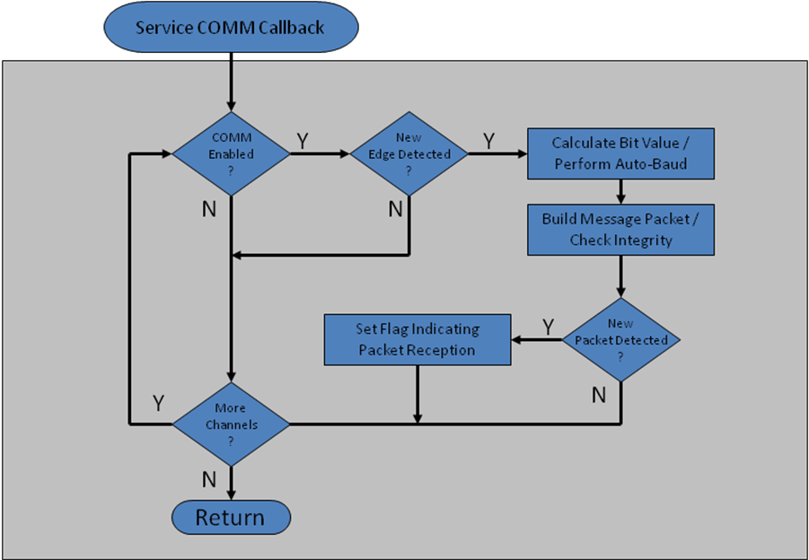
Software design
Communication handler

Slide 33
Software design
5. Key Technology
Communication Mode
Digital demodulation(DDM)
Foreign Object Detection(FOD)

Slide 34
Software design
Communication Mode
Digital demodulation
Foreign Object Detection
Speed: 2 Kbit/s
Bit-encoding: bi-phase
Byte encoding: Start-bit, 8-bit data, parity-bit, stop-bit
Packet Structure
Preamble (>= 11bit)
Header (1 Byte)
Indicates packet type and message length
Message (1 .. 27 Byte)
One complete message per packet
Payload for control
Checksum (1 Byte)
0.5ms
1
0
1
0
1
1
0
0
Start
b0
b1
b2
b3
b4
b5
b6
b7
Parity
Stop
Preamble
Header
Message
Checksum

Slide 35
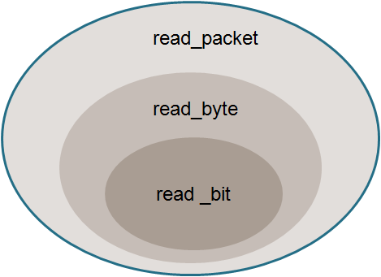
Software design
Communication Mode
Digital demodulation
Foreign Object Detection
Timer trigger by GPIO
read_bit
read_byte
read_packet

Slide 36
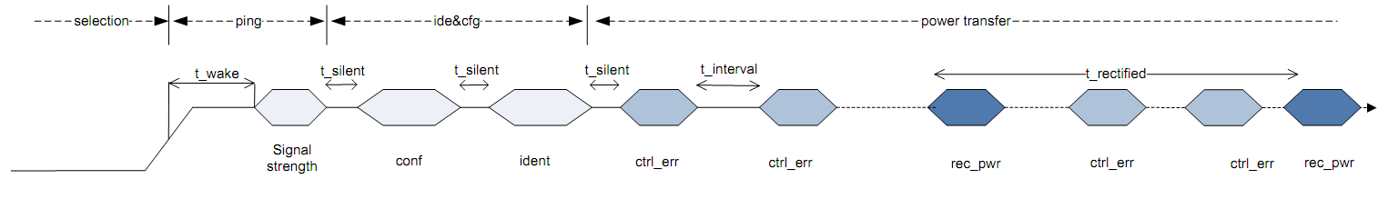
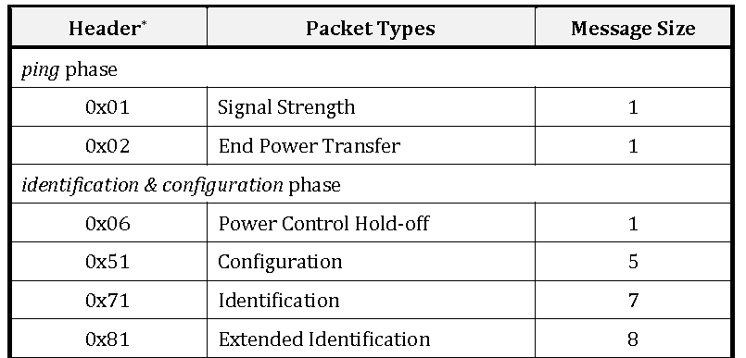
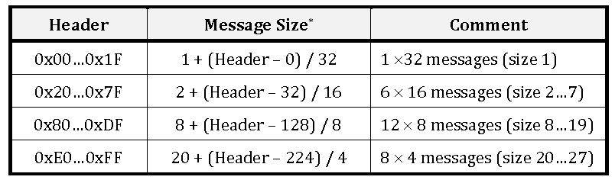
Software design
Communication Mode
Digital demodulation
Foreign Object Detection

Slide 37
Software design
Communication Mode
Digital demodulation
Foreign Object Detection
Modulation depth for original ADC sample data is too slight to be demodulated. The DDM use a simple sliding widow algorithm to omit noise and amplify the modulation depth.
The window size = half bit time / PWM cycle = 250uS*PWM_Freq.
Sliding window algorithms:
Cumulate all ADC sample data within window size, thus we will get curve 1.
Use two window, window0 and window1, window0 is just after window1. The accumulated value for window0, subtract the accumulated value for window1, thus we will get curve 2.
For curve 1, we just need to count the rising edge and falling edge points to judge the high or low modulation signal.
For curve2, we need to count the rising edge and falling edge points, we also need to count the points between two zero across positions of curve 2.

Slide 38
Software design
Communication Mode
Digital demodulation
Foreign Object Detection
The presence of foreign objects can absorb energy from the magnetic field, causing heating of the object.
The system must account for all power to detect the presence of a foreign object.
Receiver
Magnetic Flux
Foreign Object
Transmitter

Slide 39
Software design
Communication Mode
Digital demodulation
Foreign Object Detection
General Power Loss Equations
The overall power loss in the system can be calculated using the following equation:
Further, the transmitted power can be calculated using the following equation:
And the received power can be calculated as follows:
Characterization of “expected” system losses make foreign objects easily identifiable

Slide 40
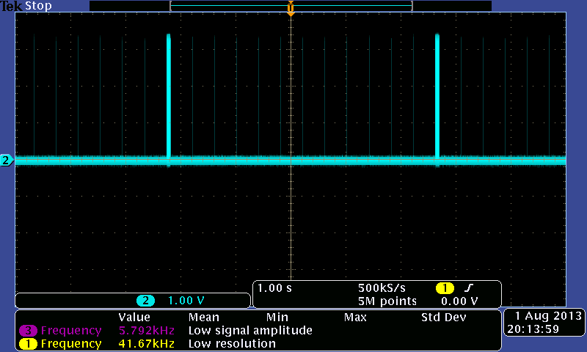
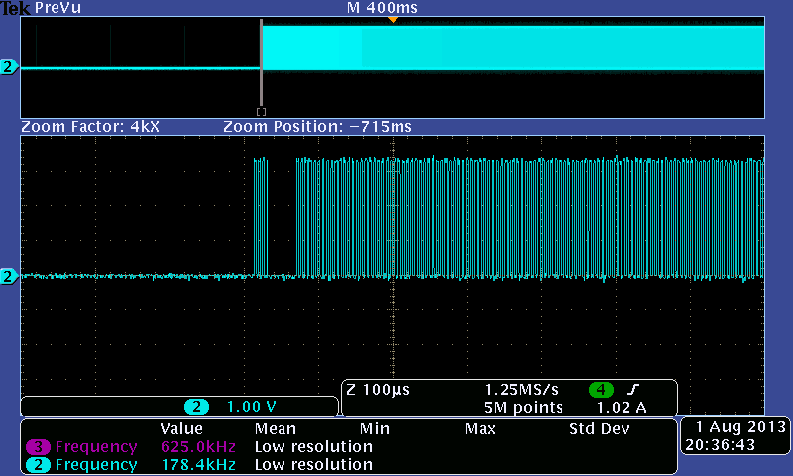
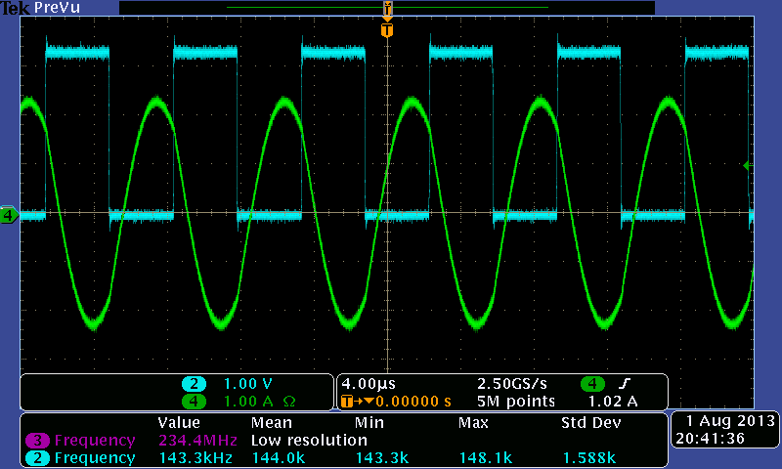
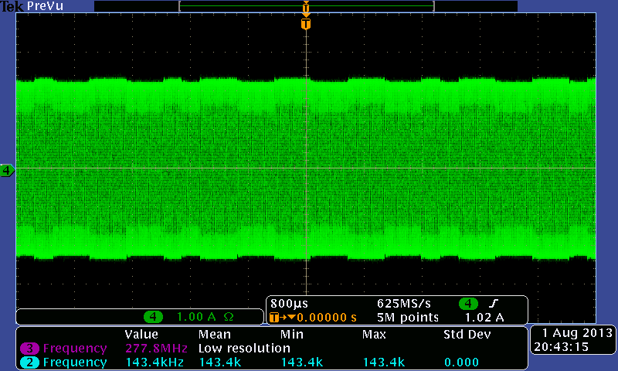
Ping Phase PWM waveform
Ping signal when Rx is putted
Coilcurrent waveform
Coilcurrent waveformwith modulation signal

